Slide 1
Class 5: Recurrent Neural Networks

Slide 2
Outline
Go from deep learning to recurrent neural networks
Introduction to sequential modelling and RNNs
Challenges: vanishing gradients
Long Short‑Term Memory (LSTM) mechanics
Manual implementation & weather example
Comparing RNNs and LSTMs
Practical tips & frameworks
Predict the weather!
[3] [4]

Slide 3
Why Sequential Models?
Traditional neural networks treat inputs independently, ignoring temporal context.
Sequential data (audio, language, weather) requires models with memory.
RNNs introduce a hidden state that carries information from prior time steps.
 | Feedforward | RNN
Memory | No internal memory | Maintains hidden state
Parameter sharing | Across layers | Across time steps
Applications | Image classification, tabular data | Time series, NLP, weather forecasting!

Slide 4
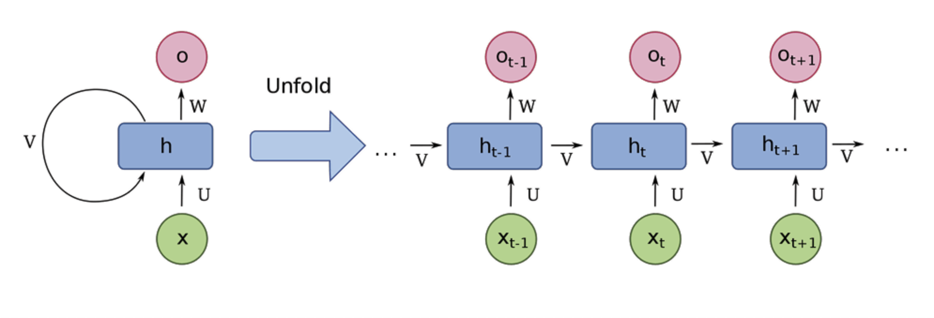
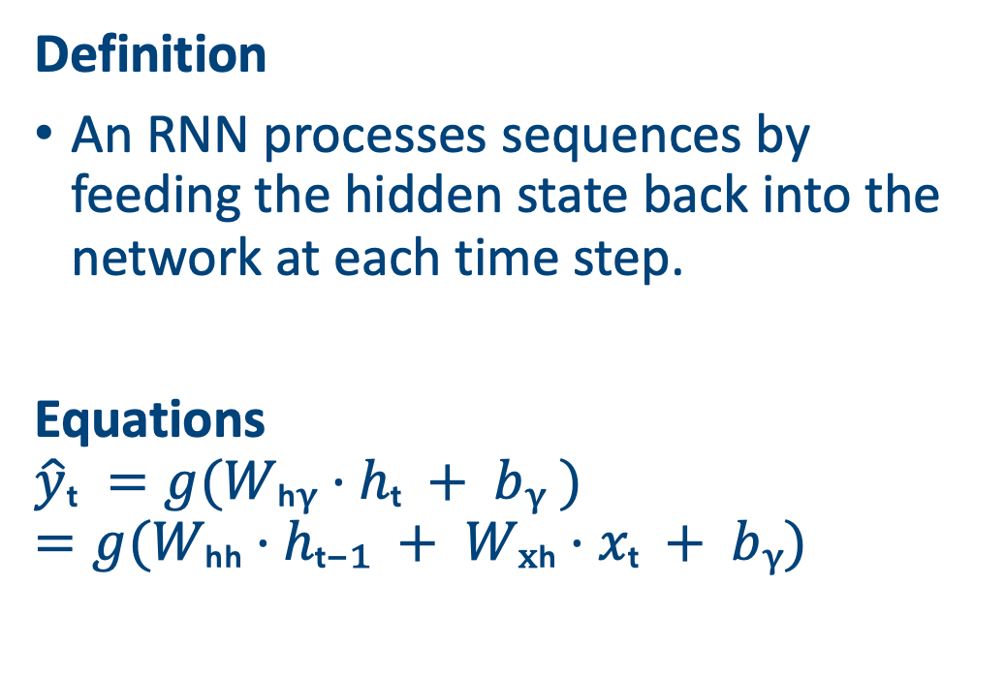
Recurrent Neural Networks
Definition
An RNN processes sequences by feeding the hidden state back into the network at each time step.
Equations
$$\hat{y}ₜ =g(Wₕᵧ·hₜ + bᵧ )=g⁡(Wₕₕ·hₜ₋₁ + Wₓₕ·xₜ + bᵧ)$$
Picture from https://www.techtarget.com/searchenterpriseai/definition/recurrent-neural-networks
Notes:
Re-create this picture to match my notation

Slide 5
Training RNNs & BPTT
Backpropagation Through Time
To train an RNN, the sequence is unrolled over time and gradients are accumulated across all time steps. This process is known as backpropagation through time (BPTT).
Challenges
Gradients can explode or vanish when propagated through many time steps, making learning long‑range dependencies difficult.

Slide 6
A weather prediction task
Use historical measurements of temperature, rainfall and humidity to predict the next day’s weather.
3 variables: temperature (°C), rainfall (mm), humidity (%)
We consider a 5‑day window to forecast the 6th day.
Go through a simple RNN on the board
Day | Temp (°C) | Rain (mm) | Humidity (%)
D1 | 20.9 | 4.23 | 69.48
D2 | 20.5 | 5.67 | 68.75
D3 | 21.0 | 6.10 | 67.04
D4 | 21.9 | 5.77 | 66.44
D5 | 22.0 | 6.60 | 62.20

Slide 7
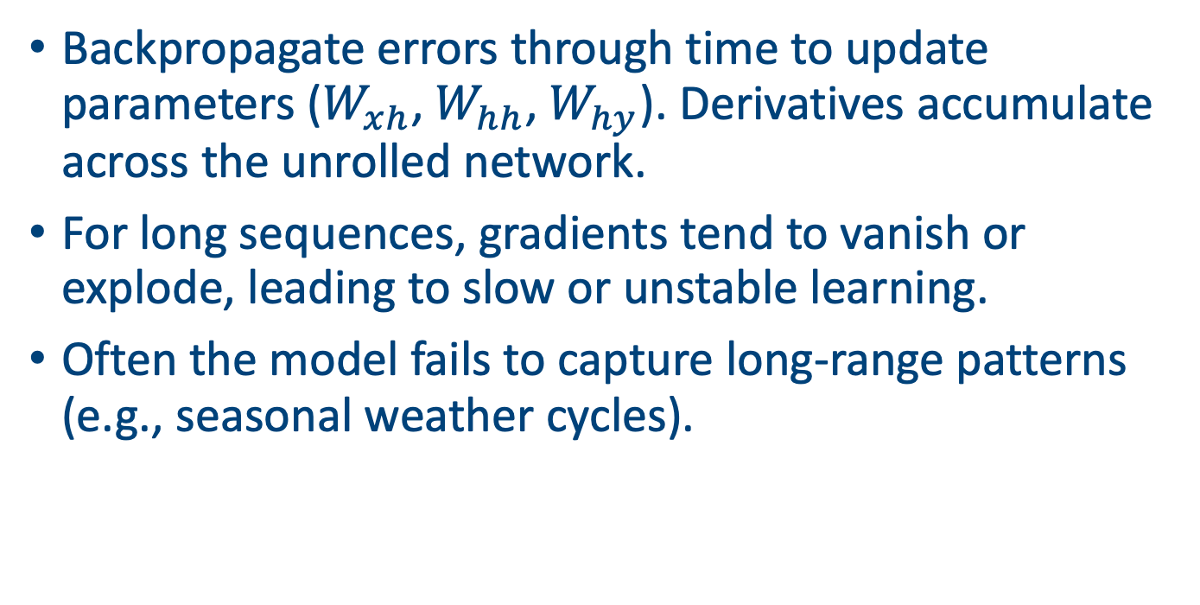
Training the RNN
Backpropagate errors through time to update parameters ($W_{xh}$, $W_{hh}$,$W_{hy}$). Derivatives accumulate across the unrolled network.
For long sequences, gradients tend to vanish or explode, leading to slow or unstable learning.
Often the model fails to capture long‑range patterns (e.g., seasonal weather cycles).

Slide 8
Implementation of an RNN
Initialize hidden state h₀ to zeros.
At each time step t:
Compute new hidden state hₜ via tanh activation
Generate output yₜ from hₜ
Store predictions for loss calculation.
import numpy as np
# weights and biases
Wxh = np.random.randn(input_dim, hidden_dim)
Whh = np.random.randn(hidden_dim, hidden_dim)
bh = np.zeros((1, hidden_dim))
Why = np.random.randn(hidden_dim, output_dim)
by = np.zeros((1, output_dim))
# forward pass
h_prev = np.zeros((1, hidden_dim))
y_preds = []
for t in range(T):
x_t = X[t] # shape (1, input_dim)
h_prev = np.tanh(x_t @ Wxh + h_prev @ Whh + bh)
y_t = h_prev @ Why + by
y_preds.append(y_t)

Slide 9
Long Short Term Memory Networks (LSTMs)

Slide 10
Long Short‑Term Memory (LSTM)
Motivation
LSTMs were proposed to overcome vanishing gradients by introducing a dedicated long term memory cell.
Key idea
Control the flow of information with ‘gates’ that learn when to forget past data, when to incorporate new input and when to expose the memory to the rest of the network.

Slide 11
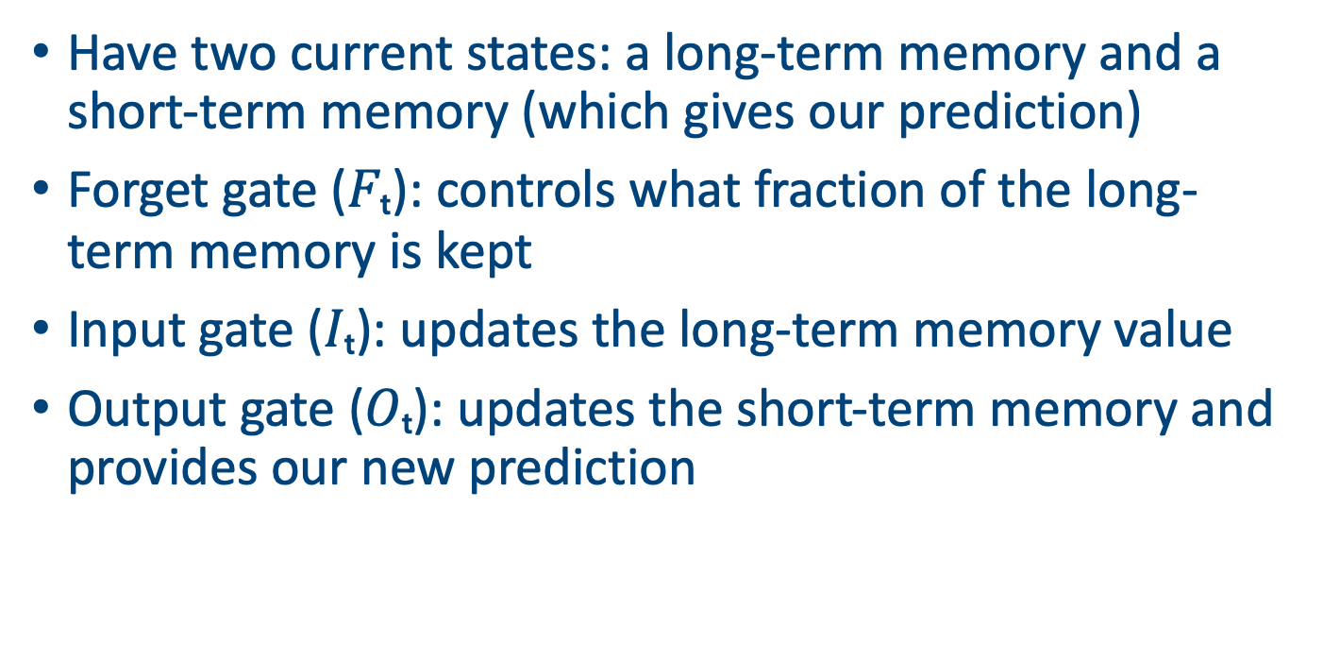
Anatomy of an LSTM Cell
Have two current states: a long-term memory and a short-term memory (which gives our prediction)
Forget gate ($Fₜ$): controls what fraction of the long-term memory is kept
Input gate ($Iₜ$): updates the long-term memory value
Output gate ($Oₜ$): updates the short-term memory and provides our new prediction

Slide 12
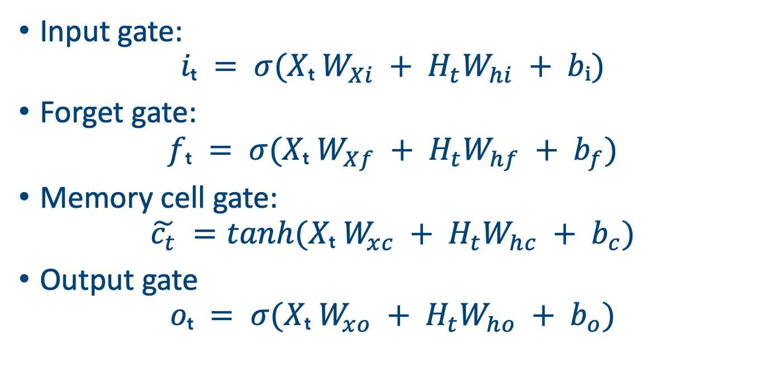
First set of gates
Input gate:
$$iₜ = σ(Xₜ W_{Xi} + H_{t}W_{hi} + bᵢ)$$
Forget gate:
$$fₜ = σ(Xₜ W_{Xf} + H_{t}W_{hf} + b_{f})$$
Memory cell gate:
$$\tilde{c_{t}} =tanh(Xₜ W_{xc} + H_{t}W_{hc} + b_{c})$$
Output gate
$$oₜ = σ(Xₜ W_{xo} + H_{t}W_{ho} + b_{o})$$

Slide 13
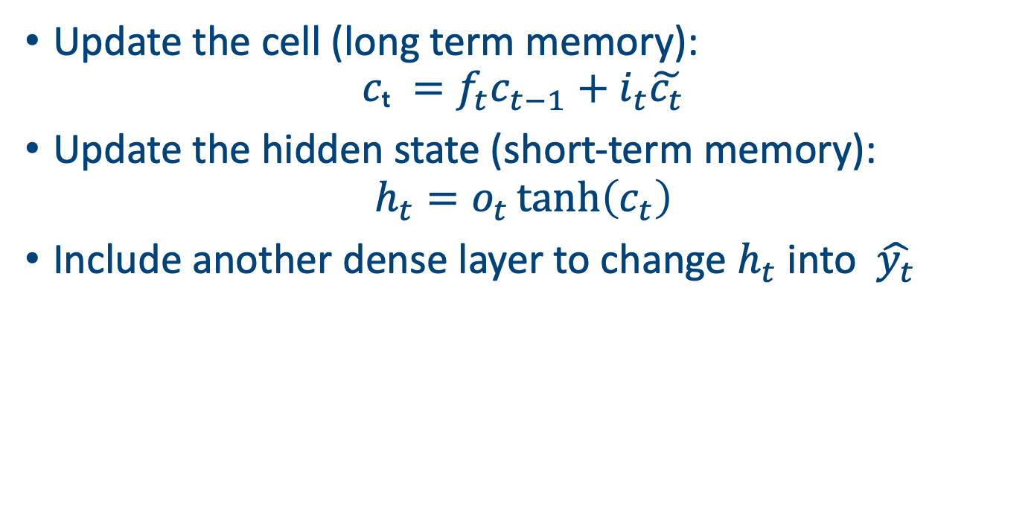
Updates
Update the cell (long term memory):
$$cₜ =f_{t}c_{t−1}+i_{t}\tilde{c_{t}}$$
Update the hidden state (short-term memory):
$$h_{t}=o_{t}\tanh\left(c_{t}\right)$$
Include another dense layer to change $h_{t}$ into $\hat{y_{t}}$

Slide 14
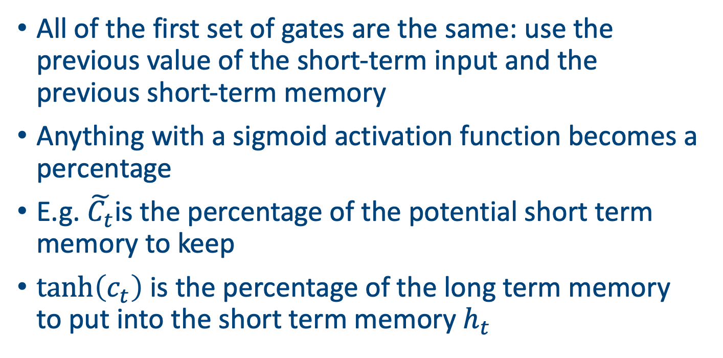
Intuition
All of the first set of gates are the same: use the previous value of the short-term input and the previous short-term memory
Anything with a sigmoid activation function becomes a percentage
E.g. $\tilde{C_{t}}$is the percentage of the potential short term memory to keep
$\tanh\left(c_{t}\right)$ is the percentage of the long term memory to put into the short term memory $h_{t}$

Slide 15
LSTM diagram
All more straightforward with an example on the board

Slide 16
Preparing Input Sequences
Windowing
Create training examples by sliding a fixed‑length window over the data.
Normalisation
Scale each feature to zero mean and unit variance to ensure stable learning.
Training/Testing split
Divide the sequences into training and validation sets to evaluate performance.

Slide 17
Implementing the LSTM
Separate parameters for each gate
Maintains both hidden short-term state (hₜ) and cell long-term state (Cₜ)
Uses elementwise operations to update the cell and hidden state
Nonlinearity: sigmoid for gates, tanh for candidate and cell output
import numpy as np
# initialise weights for gates
Wxi,Wxf,Wxo,Wxc = [np.random.randn(input_dim, hidden_dim) for _ in range(4)]
Whi,Whf,Who,Whc = [np.random.randn(hidden_dim, hidden_dim) for _ in range(4)]
bi,bf,bo,bc = [np.zeros((1, hidden_dim)) for _ in range(4)]
Wy = np.random.randn(hidden_dim, output_dim)
by = np.zeros((1, output_dim))
# forward pass
h_prev = np.zeros((1, hidden_dim))
C_prev = np.zeros((1, hidden_dim))
y_preds = []
for t in range(T):
x_t = X[t]
I = sigmoid(x_t @ Wxi + h_prev @ Whi + bi)
F = sigmoid(x_t @ Wxf + h_prev @ Whf + bf)
O = sigmoid(x_t @ Wxo + h_prev @ Who + bo)
C_tilde = np.tanh(x_t @ Wxc + h_prev @ Whc + bc)
C_prev = F * C_prev + I * C_tilde
h_prev = O * np.tanh(C_prev)
y_t = h_prev @ Wy + by
y_preds.append(y_t)

Slide 18
LSTM Training & Predictions
Use gradient descent and backpropagation through time to update all gate parameters.
The LSTM learns to follow the general trend of the weather variables and reduce forecasting error over time.
Can produce similar graphs for rainfall and humidity.

Slide 19
RNN vs LSTM: A Comparison
LSTMs trade computational efficiency for better performance on long sequences.
When sequence lengths are short, a simple RNN may suffice.
For very long sequences or parallelisable tasks, Transformer architectures might be preferred.
Coming next!
 | RNN | LSTM
Memory | Single hidden state hₜ | Hidden state hₜ and cell state Cₜ
Gates | None | Input, forget & output gates
Vanishing gradient | Severe | Mitigated
Parameter count | Fewer | More due to multiple gates
Use cases | Short sequences | Long‑range dependencies

Slide 20
Implementing LSTM with PyTorch
import torch, torch.nn as nn
lstm = nn.LSTM(input_size=1, hidden_size=8, num_layers=1)
readout = nn.Linear(8, 1) # Turns the hidden layer into a single output
opt = torch.optim.Adam(list(lstm.parameters())+list(readout.parameters()), lr=0.1)
for _ in range(300):
h, _ = lstm(x)
yhat = readout(h)
loss = ((yhat - y)**2).mean()
opt.zero_grad(); # Clears old gradients
loss.backward(); # Computes the gradients and the loss function
opt.step() # Updates the parameters
print(f"final MSE: {loss.item():.4f}")

Slide 21
Other applications of RNNs/LSTMs
Natural language processing: language modelling, machine translation, sentiment analysis
Speech recognition and synthesis
Time‑series forecasting (weather obvs, finance, IoT)
Biological sequence analysis: DNA/RNA modelling
Music generation and audio signal processing

Slide 22
Other RNNs
Gated Recurrent Unit (GRU)
Simplified version of LSTM with fewer gates (update and reset). Competitive performance with fewer parameters.
Bidirectional RNN/LSTM
Processes sequences forwards and backwards to capture past and future context.
Transformers
Self‑attention mechanisms remove recurrence entirely, enabling parallel processing and better long‑range modelling.

Slide 23
Practical tips
Normalise and scale your inputs to accelerate convergence.
Choose sequence length based on the task’s (maximum) temporal dependencies.
Use regularization (dropout, L2) and gradient clipping to prevent overfitting and exploding gradients.
Monitor training/validation curves to detect underfitting or overfitting.
If LSTMs don’t work for you, experiment with other types of RNN

Slide 24
Summary
RNNs enable sequential modelling by maintaining a hidden state but struggle with gradients.
LSTMs introduce gates and a cell state to mitigate these issues and learn long‑range dependencies.
Manual implementations provide insight into the underlying operations and challenges.
Practical applications span NLP, speech, time‑series analysis and beyond.
Modern frameworks (Keras/PyTorch) simplify experimentation and deployment.

